Slide 1


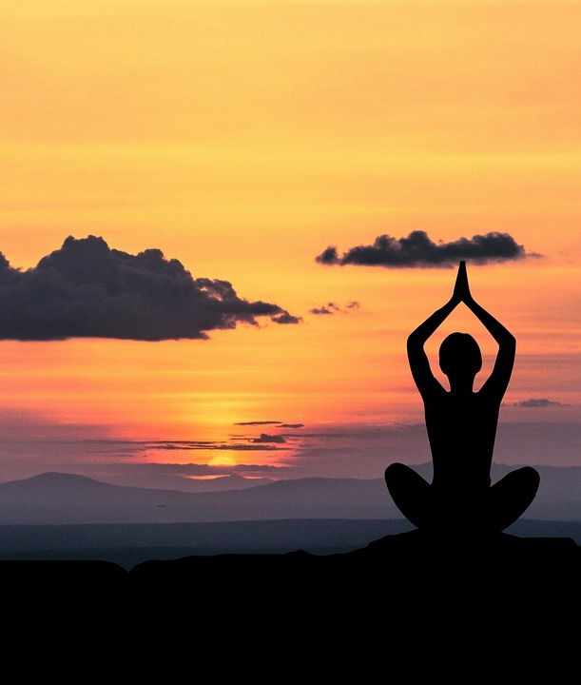
Swasth Jeevan
Bhavesh potale

Slide 2
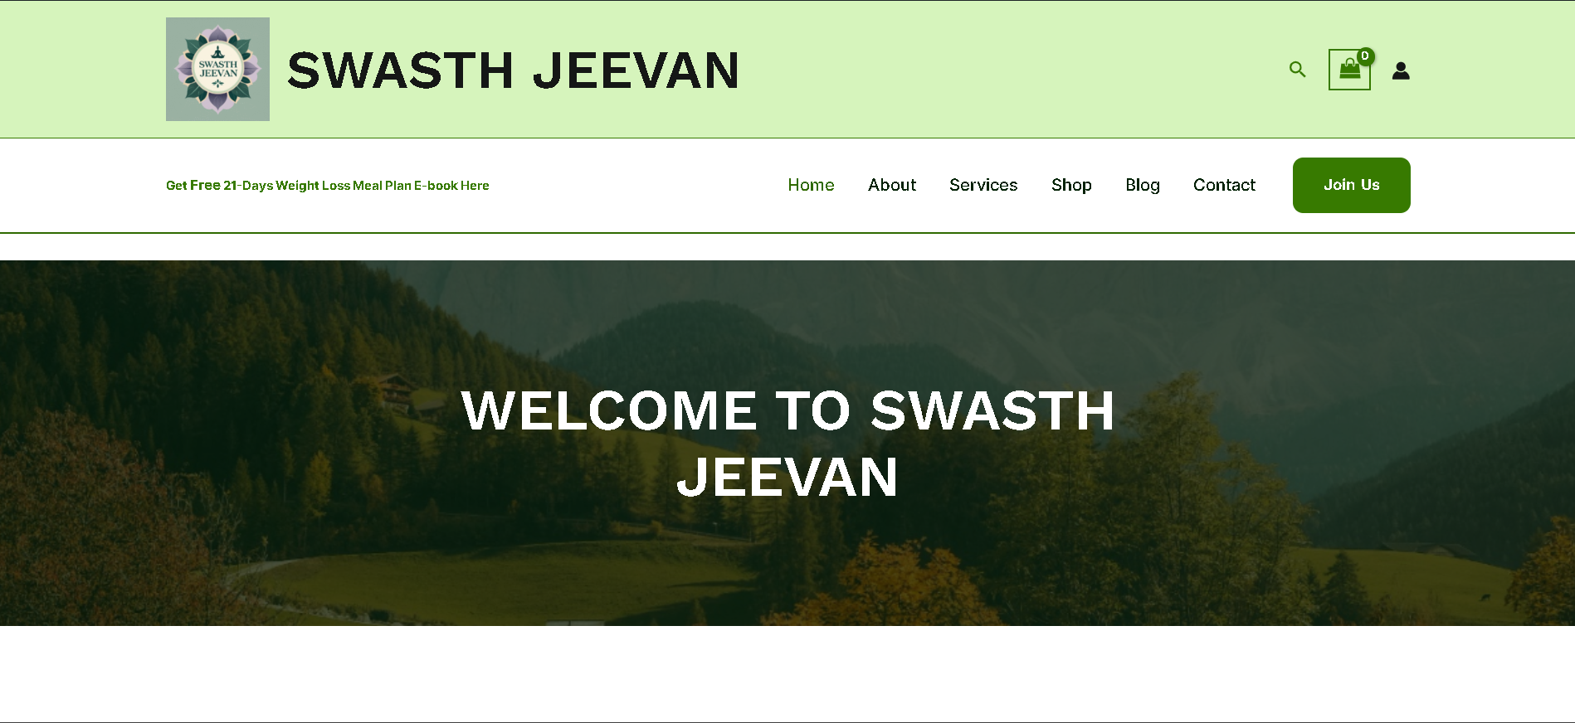
About Swasth Jeevan
Brand Introduction
Swasth Jeevan is a Mumbai-based wellness brand offering Yoga, Strength Training, Meditation, and affordable Wellness Service. Our goal is to help people build a healthy, balanced lifestyle through simple, practical, and holistic wellness solutions.
Brief History
Started as a small community yoga initiative, Swasth Jeevan has grown into a complete wellness platform. With increasing demand for accessible health guidance, the brand expanded into strength training, meditation programs, and curated fitness accessories.
Mission Statement
To empower individuals to achieve physical fitness, mental clarity, and everyday well-being through accessible wellness services and thoughtfully designed products.

Slide 3
Competitor research
Competitors |  | Presence
Website Link | Website Name | Website | Facebook | Instagram | X-Platform | Youtube | Linkedin | WhatsApp
https://swasthjeevan.unaux.com/ | Swasth Jeevan | P | P | P | P | P | P | O
https://www.drkomalswellness.com/ | DR. Komals wellness | P | P | P | O | O | P | P
https://goeclipse.co.in/ | goeclipse | P | P | P | O | P | P | O
https://www.cult.fit/ | Cult | P | P | P | P | P | P | O
https://yoga365.in/ | Yoga365 | P | P | P | O | P | O | P
Tool: Manual, moz.com

Slide 4
Swot analysis
Website Name | Strengths | Weaknesses | Opportunities | Threats
DR. Komals wellness | • Professional medical-wellness positioning • Strong credibility due to doctor-led brand • Focus on therapy, diet, and holistic programs | • Very niche target audience • Limited product range • Less youth-oriented branding | • Collaboration with clinics and wellness experts • Growing interest in medical wellness • Expansion into preventive health programs | • Competition from fitness-focused brands • Pricing may discourage budget-conscious users • Market shifting more toward fitness + digital apps
goeclipse | • Strong product catalog (fitness accessories) • Modern eCommerce website • Active social media promotions | • Product-only focus (no services) • Higher pricing compared to small brands • Lower community engagement | • Increasing demand for home workout gear • Potential for influencer partnerships • Launch of bundles / combos | • Competing against well-known fitness brands • Price wars with low-cost sellers • Market saturation in accessories
Cult | • Strongest brand recognition • Online + offline fitness ecosystem • Massive social media presence • Variety of services (gym, yoga, app workouts) | • Premium pricing • Too large — less personal connection • Not focused on local micro-communities | • More expansion into small cities • Hybrid fitness programs • Corporate partnerships | • Smaller affordable brands gaining traction • High customer expectations • Difficult to maintain low prices at scale
Yoga365 | • Pure yoga-focused niche • Clean brand identity • Good for beginners looking for yoga classes | • Limited fitness variety (only yoga) • Weak social media compared to big competitors • Less product offerings | • Expand into meditation courses • Offer online classes & workshops • Sell yoga accessories | • Competition from larger yoga brands • Market preference shifting toward mixed fitness • Hard to stand out with limited offerings

Slide 5
Swot analysis
Website Name | Strengths | Weaknesses | Opportunities | Threats
Swasth Jeevan | Holistic wellness offerings (Yoga, Strength Training, Meditation + Products) Affordable pricing for beginners Minimal, clean branding that builds trust Local focus (Mumbai & Navi Mumbai) | Low brand recognition (new brand) Limited product & service range (4 items currently) Weak SEO history & low social presence Lower marketing budget Dependence on suppliers for quality & delivery | Rising demand for home fitness & wellness Expand products (bands, bottles, mats, supplements) Online services (plans, consultations, classes) Content & blog marketing for organic traffic Local partnerships with gyms/yoga studios | Strong competition (Cult.fit, GoEclipse, Yoga365) Ad competition & high marketing costs Supply chain risks in dropshipping Customer preference for big integrated platforms Price-sensitive market

Slide 6
Brand identity
Swasth Jeevan Logo
Why These Colors?
A harmonious, nature-inspired palette that communicates peace, trust, and holistic wellness, supporting the spiritual, balanced identity of Swasth Jeevan.
Logo Explanation
Meditative figure represents mindfulness, balance, inner health
Lotus mandala symbolizes purity, growth, holistic healing
Circular shape reflects unity and continuous healthy living
Colors create a serene, trustworthy wellness atmosphere
Color | Meaning
Sage Green (#88B892) | Calmness, balance, natural wellness
Deep Teal (#0F5F62) | Trust, emotional stability, premium feel
Warm Sand Beige (#E3C8A8) | Comfort, warmth, grounded simplicity
Tag Line: Fitness That Heals, Yoga That Empowers.
Logo Color Breakdown:
Muted Sage Green / Mint Green, Dark Forest Green / Teal-Green, Muted Lavender / Mauve, Warm sand beige, Dark Teal / Very Dark Green.

Slide 7
Social Media setup
social media profiles for the brand
Website: https://swasthjeevan.unaux.com/
Social Media | Link
Website | https://swasthjeevan.unaux.com/
Facebook | https://www.facebook.com/people/Swasth-Jeevan/61586081186555/
Instagram | https://www.instagram.com/swasth_jeevan.project/
YouTube | https://www.youtube.com/@Swasth_Jeevan-SJ2025
X-platform | https://x.com/Bhaveshp175472
LinkedIn | https://www.linkedin.com/company/swasth-jeevan-sj

Slide 8
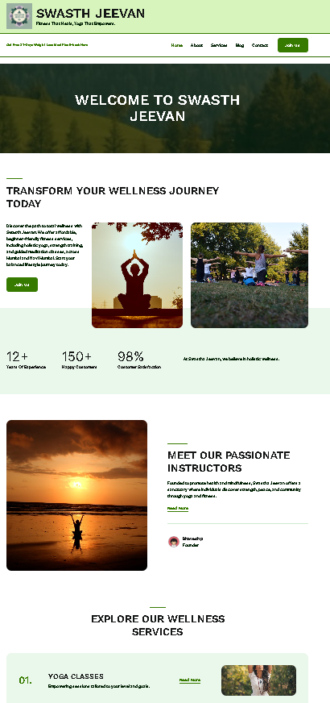
Website devlopment
Website: https://swasthjeevan.unaux.com/
How the Website Supports the Swasth Jeevan Brand
1. Strengthens Brand Identity
Uses the brand’s calming colors, logo, and visuals to create a consistent wellness experience
Reflects the values of peace, balance, and holistic living
2. Builds Trust & Credibility
A professional, structured website assures visitors that Swasth Jeevan is reliable and authentic
Helps create a strong first impression for new users
3. Clear Presentation of What We Offer
Users can easily understand the brand’s purpose, services, and wellness message
Simple navigation improves the user journey and boosts engagement

Slide 9
Website devlopment
Website: https://swasthjeevan.unaux.com/
How the Website Helps the Audience
1. Easy Access to Information
Visitors can quickly find wellness guidance, brand updates, and contact options
Available 24/7, anytime and anywhere
2. Valuable Content for Healthy Living
Space to share tips, articles, or wellness insights that support the tagline:
“Healthy Living, Every Day.”
3. Community Building
Creates a central hub where people can connect with the brand
Enables future features like blogs, newsletters, or wellness programs
4. Long-Term Digital Home
As the brand grows, the website can expand with new content, services, or e-commerce
Strengthens long-term engagement and audience connection

Slide 10
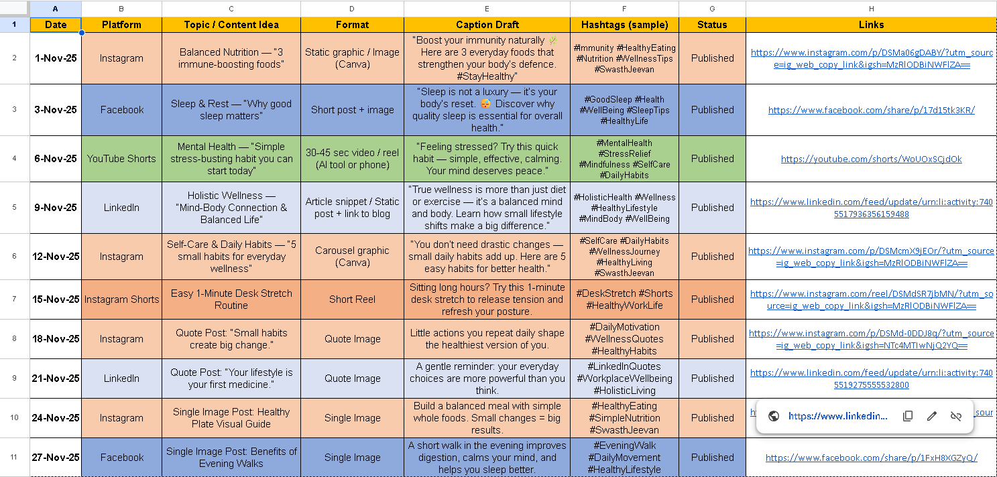
Organic marketing
Social Media Calendar
https://docs.google.com/spreadsheets/d/1s57AakUmVRmG09miht1_awR3fMvr3s3t/edit?usp=sharing&ouid=108142461127455163731&rtpof=true&sd=true

Slide 11
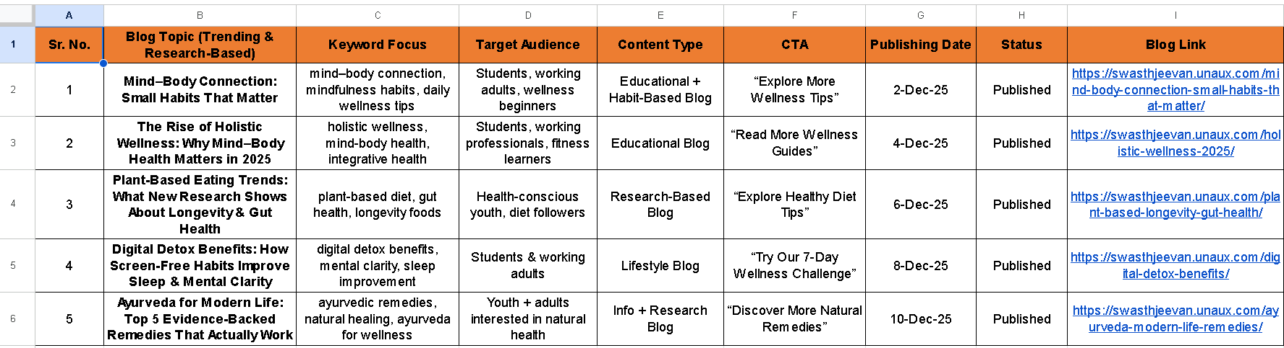
Content optimization
Content calendar for the blog
https://docs.google.com/spreadsheets/d/17cwundpy1LW8SSfAwXS6dwDIcd6ktAoA/edit?usp=sharing&ouid=108142461127455163731&rtpof=true&sd=true

Slide 12
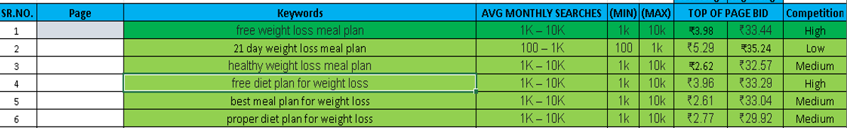
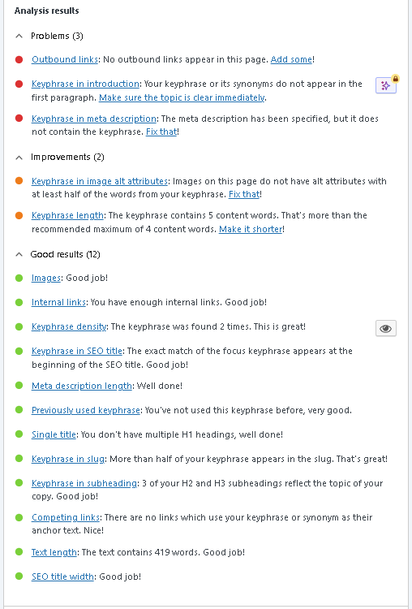
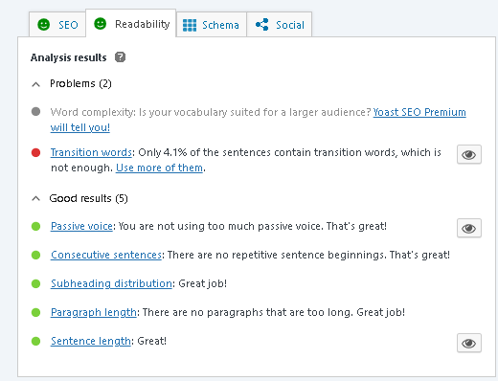
On page seo
On Page SEO Page
https://swasthjeevan.unaux.com/21days-weight-loss-meal-plan/
Keyword Strategy: Five highly relevant keywords were selected based on search volume and competition analysis. The goal was to target high-potential, achievable terms to drive targeted organic traffic.
Yoast SEO Implementation: The selected focus keyphrase and corresponding on-page optimizations (Title, Meta Description, Content, etc.) were strategically integrated into the page.
Detailed Report:
https://docs.google.com/document/d/15hSQOo8xkOwIOdOJ9Y7-bRknKqsNrteZ/edit?usp=sharing&ouid=108142461127455163731&rtpof=true&sd=true

Slide 13
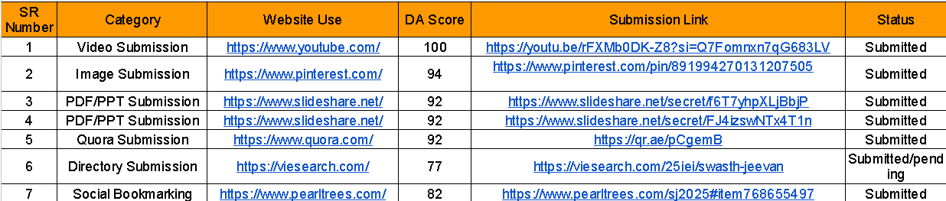
Off page seo
https://docs.google.com/spreadsheets/d/1qXSj6MrM7A_ta9oQSogqXtNcWwT_on7E/edit?usp=sharing&ouid=108142461127455163731&rtpof=true&sd=true
Tool used:
DA Score: moz.com | ahrefs.com | smallseotools.com
Website Traffic: ahrefs.com

Slide 14
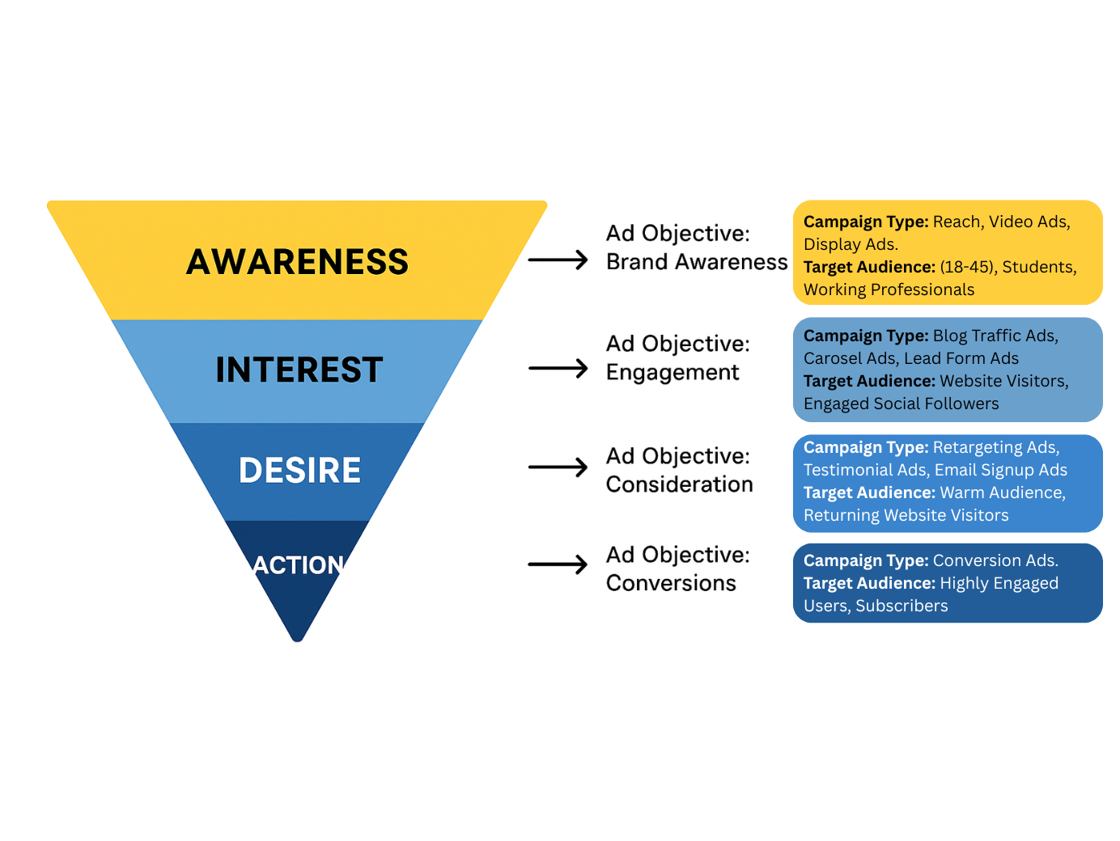
Funnel creation
AIDA Funnel for Swasth Jeevan
Awareness
Objective: Brand Awareness & Reach
Content: Reels, infographics, motivational posts, short wellness videos
Audience: New users (18–45), students, working professionals
Goal: Introduce brand and create visibility
Interest
Objective: Engagement / Traffic
Content: Blogs, wellness guides, how-to posts, carousels
Audience: Website visitors, engaged followers
Goal: Build trust and keep users interested in wellness content
Desire
Objective: Consideration
Content: Testimonials, advanced wellness tips, deeper blog topics
Audience: Warm audience, returning visitors
Goal: Create emotional connection & inspire action
Action
Objective: Leads / Conversions / Signups
Content: CTA posts, newsletters, wellness challenges
Audience: Highly engaged users
Goal: Convert them into subscribers or loyal community members

Slide 15
Paid marketing stretegy
Campaign Budget Planning – Overview
Total Paid Advertising Budget: ₹1,00,000
To ensure efficient use of budget, the total amount is distributed across platforms and funnel stages based on user intent and reach potential.
Platform | Budget
Facebook & Instagram | ₹30,000
Google Ads | ₹50,000
LinkedIn Ads | ₹20,000
Total | ₹1,00,000

Slide 16
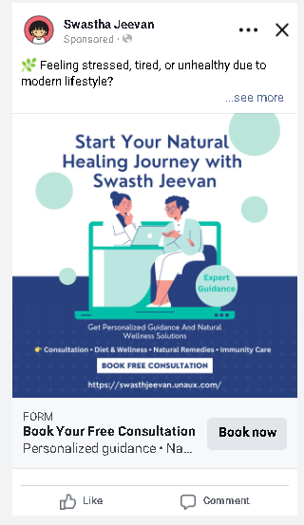
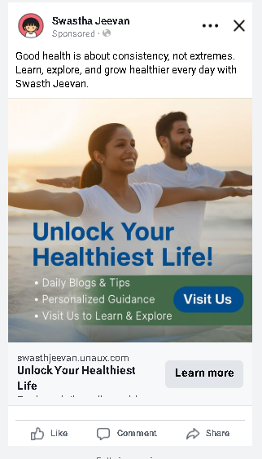
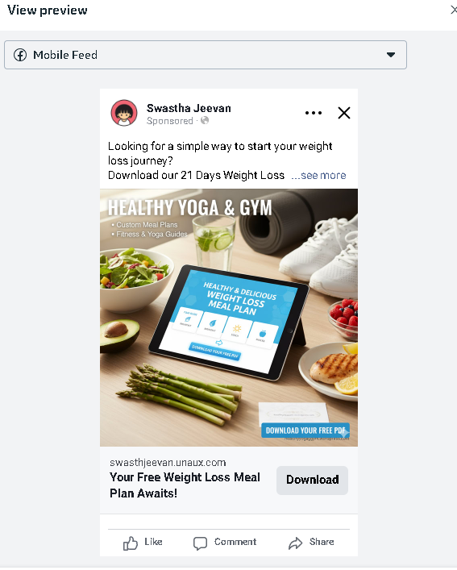
Paid marketing stretegy
Facebook & Instagram Campaign Budget Planning
Total Budget: ₹30,000
Facebook & Instagram are used to engage users across all funnel stages using visual and interest-based targeting.
Meta Ads Setup
Funnel Stage | Campaign Objective | Campaign Type | Budget/day
Awareness | Brand Awareness / Reach | Video & Image Ads | ₹12,000 (30 days)
Interest | Traffic | Blog / Website Visit Ads | ₹10,000 (30 Days)
Action | Lead Generation | Signup / Instant Form Ads | ₹8,000 (30 Days)
Total | — | — | ₹30,000
Reason:
Higher budget is allocated to awareness to reach a wider audience, while lead generation focuses on warm users for better conversions.

Slide 17
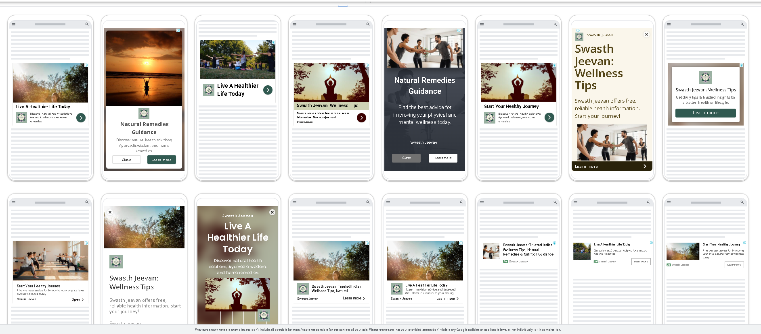
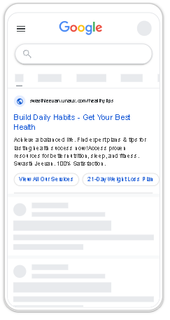
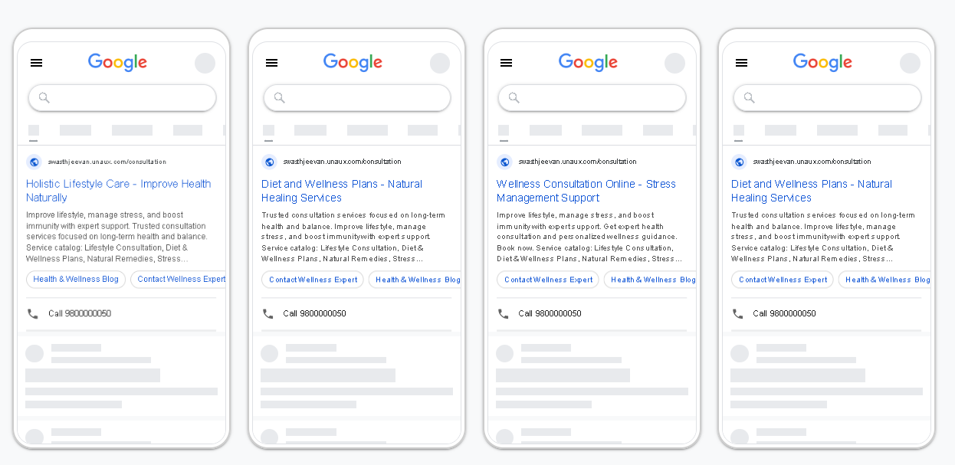
Paid marketing stretegy
Google Ads Setup
Google Ads Campaign Budget Planning
Total Budget: ₹50,000
Google Ads targets users with high intent through search, display, and retargeting campaigns.
Funnel Stage | Campaign Type | Objective | Budget
Awareness | Display Ads | Brand Awareness | ₹15,000 30- days
Interest | Search Ads | Website Traffic | ₹25,000 15- day
Action | Retargeting Ads | Leads / Conversions | ₹10,000 30- days
Total | — | — | ₹50,000
Reason:
Search ads receive the highest budget due to strong intent-based traffic, while retargeting ensures higher conversion rates.

Slide 18

Paid marketing stretegy
LinkedIn Ads Campaign Budget Planning
Total Budget: ₹20,000
LinkedIn Ads are primarily used for high-intent professional users, focusing more on website visits and lead generation than mass awareness.
Funnel Stage | Campaign Objective | Campaign Type | Budget-(days)
Awareness | Brand Awareness | Sponsored Content (Image/Video) | ₹4,000 (5-days)
Interest | Website Visits | Blog / Website Visit Ads | ₹6,000
Action | Lead Generation | LinkedIn Lead Gen Forms | ₹10,000
Total | — | — | ₹20,000
LinkedIn Ads Setup

Slide 19
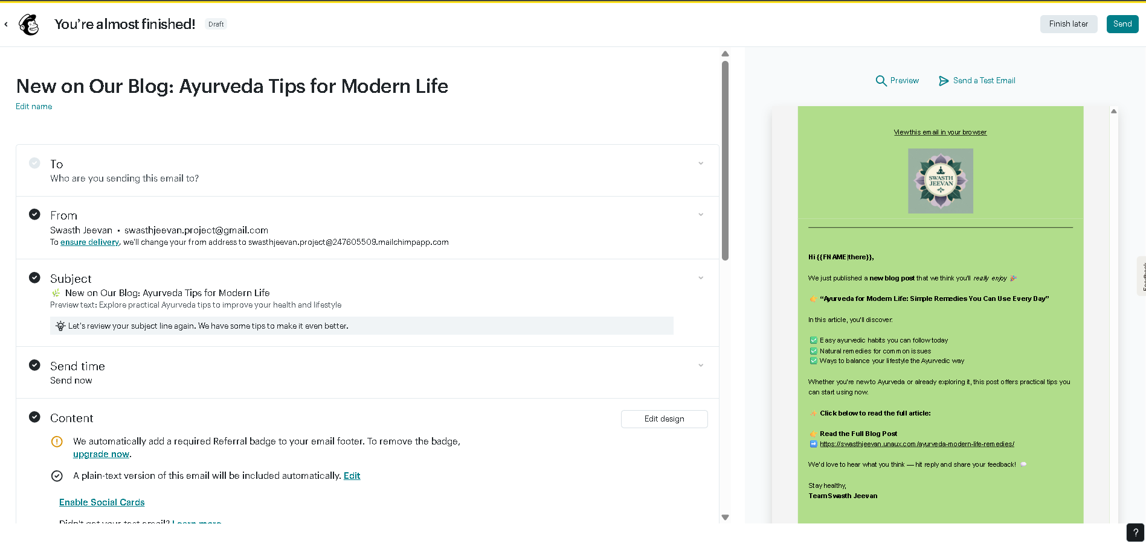
Engagement strategies
Objective:
To increase audience engagement and drive traffic to the website by sharing valuable Ayurvedic content.
Tool Used:
Mailchimp (Email Marketing Platform)
Email Campaign Details:
Email Type: Engagement / Blog Update Email
Subject Line: New on Our Blog: Ayurveda Tips for Modern Life
Content Focus: Ayurveda remedies for modern lifestyle challenges
Personalization: Subscriber name used in greeting
CTA (Call to Action): Read the Full Blog Post
Engagement Approach:
The email shares educational content, highlights key benefits from the blog, and encourages readers to visit the website for detailed information.
Result Expectation:
Higher email open rate
Increased blog page visits
Improved brand trust and audience connection
https://us11.campaign-archive.com/?e=[UNIQID]&u=d5e144a1fb8bf2da7dad8d210&id=7e8892d6ec

Slide 20
Digital marketing & ai tools
Website & SEO Tools
Privacy Policy Generator | Terms & Conditions Generator | Google Keyword Planner | PageSpeed Insights | Moz / Ahrefs (Free) | site24*7
Content, Design & AI Tools
ChatGPT | Google Gemini | Canva / Canva AI | VEED.io | pexels
Other Tools
Meta Business Suite | Meta Ads Library | YouTube Studio | Google Analytics 4 (GA4) | Google Trends | Mailchimp / Brevo | NU HTML Checker | Open Graph Generator | Twitter Card Generator | Broken Link Checker | Semrush SERP Checker

Slide 21
Thank You

